Slide 1
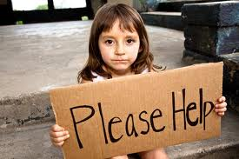
Charity and Money
By: Lola Roldán Martín
Address: Plaza de la Religiosa Filipense Dolores Márquez 1, 29007 Málaga (España)

Slide 2
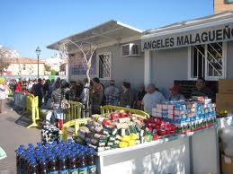
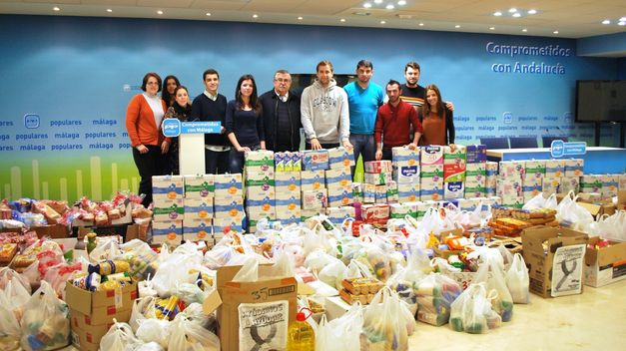
Ángeles de la Noche
Ángeles de la Noche is a charity that
gives lots of food to the poor. This food is donated by the public. They give food and drink to every single person that is poor, and lots of people go there. The charity is very kind and, if you are sick, they give you medicine and take old poor people to shelters.

Slide 3
What is a Charity?
A charity is when kind people want to give money, food and clothes to shelters so they can give it to poor people.

Slide 4
What does this charity do?
This charity gives food and water to poor people that need it. If they see they are on drugs they would call the police so they can help them, yet they also help old people to find a shelter.

Slide 5
Where is this charity?
This charity is in front of the Dolores del Puente and Mena brotherhood in the centre of Malaga.

Slide 6
How can we help this charity?
We can help this charity by everyone in St George’s School bringing some food or bottles of water. Believe me, they are very good people.

