Slide 1
What is a Charity?
A charity is a group of people that help other people that haven´t got homes, food or even water.
By: Manuel Abaurre

Slide 2
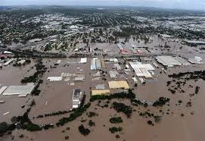
Caritas
Caritas is a charity that focuses on five special key aspects: health, conflicts, disasters, food and development.

Slide 3
Who does it help?
This charity, Caritas, helps all the people of the world because they want to have a world without disasters or poverty..

Slide 4
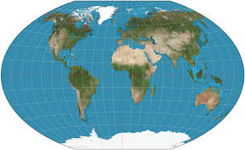
Where is it?
Caritas works in: Africa (Congo, Kenya, Malawi, Mozambique, South Africa, Suda and South Sudan, Tanzania, Uganda, Zambia and Zimbawe); Asia (Bangladesh, Burma, Cambodia, China, East Timor, India, Indonesia, Lao PDR, Nepal, Pakistan, Philippines, Sri Lanka and Vietnam); Latin America (Bolivia, Brasil, El Salvador, Haiti and Peru); Pacific (Fiji, Papua New Guinea, Samoa, Solomon Islands and Vanuatu); and Australia.

Slide 5
How Can We Help This Charity?
We can help this charity by: donating money, clothes, food and medicines (especially money).
www.caritas.org.au/
www.adelaide.catholic.org.au/giving/caritas-australia

