Slide 1
Unicef
By Marta Forster

Slide 2
Which charity have i chosen and why?
I have chosen UNICEF because they are helping lots of countries over the world, with a large number of problems such as hunger, education, resources, viruses, bacterias, etc.

Slide 3
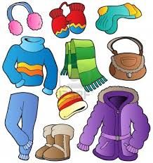
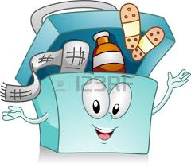
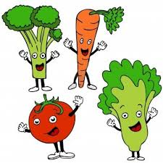
What is a charity?
Charity is aid that consists of giving clothes, money, medicines, and food to people who need it.

Slide 4
What does unicef do?
Child protection and social inclusion.
Child survival.
Education.
Emergencies and humanitarian action.

Slide 5
Who does it help?
UNICEF works with the government and with partners to help children that suffer from lots of diseases.

Slide 6
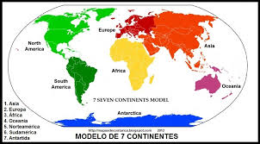
Where does UNICEF work?
Central and Eastern Europe.
East and South Asia
Pacific Eastern
Southern, West, North and Central Africa
Latin America
Caribbean Middle East

Slide 7
How can we help UNICEF?
Donations.
Sign up to eNews.
Buy UNICEF gifts.
Help vaccinate every child.
Leave a legacy.
Connect and share.

Slide 8
WEBPAGE REFERENCE
www.unicef.org

