Slide 1
Charity Water. by: Harald

Slide 2
¿What is a charity?
A charity is a dontation someone makes to benefit the people in need.
Usually when you donate you give money, but somtimes you give things that you don’t need like toys, clothes or anything you want to donate.

Slide 3
¿What does this charity do?
Charity Water donates water to people who need it.
They donate water because some people can’t get clean water, they need to go walking for hours finding a pond or a lake, put some water in a bottle, and later on drink it, they know that it’s unhealthy and disgusting, but what other choice do they have?

Slide 4
¿Who does it help?
It helpes people that work hard and along time to get water, and this charity hepls those people so they can get clean and healthy water.
You might ask ¿why water? And that is because the poor spend almost all day to get water instead of learning, or other things and because dirty water can leave desieases and even death, and some of them know that. And these problems affect mothers and children the most.

Slide 5
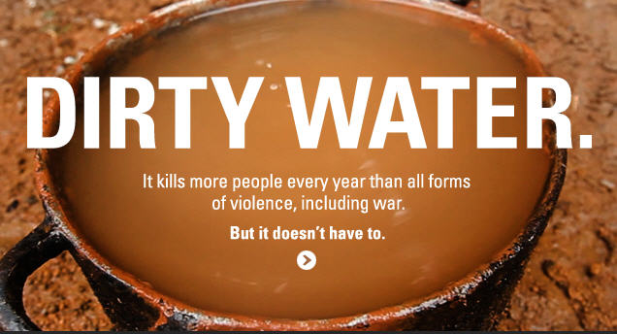
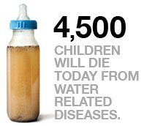
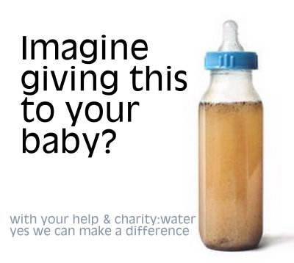
Where is this charity?
Charity wáter takes place in New York, and it helps people mostly in Ethopia.

Slide 6
How can we help this charity?
We can buy its products for example clothing, water, food or donate to their website.
Then they will give water to the country and help people with the money they get.

Slide 7
The history of this charity.
This charity started in Scott Harrisons 30th birthday.
But he told them to bring 20 dollars instead of a gift, and 700 people came, so he made an office, then a website and then products, the next birthay he did the same but with 30 dollars instead, and each year more and more people came and donated, so he started making more products.

