Slide 1
What is a charity?
I chose Oxfam because I like how it fights for the poor to give them food, and my family supports it.
What does this charity do?
How can we help?
What is the history of this charity?
Where is this charity?
By Jorge Crespo
THE END

Slide 2
What is a charity?
A charity is a non-profit organisation that helps one group of people to support another. It also helps animals or protects the environment.

Slide 3
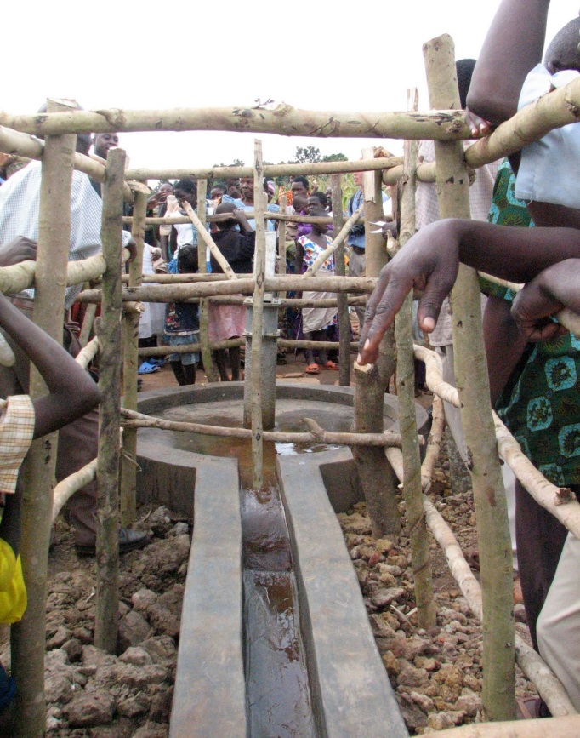
What does this charity do?
Oxfam helps by giving water and food to poor people. It also opens up new schools, creates fair trades and offers jobs to people.

Slide 4
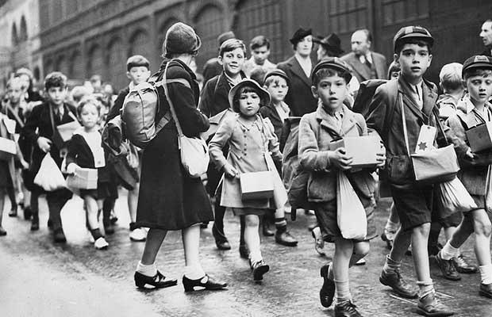
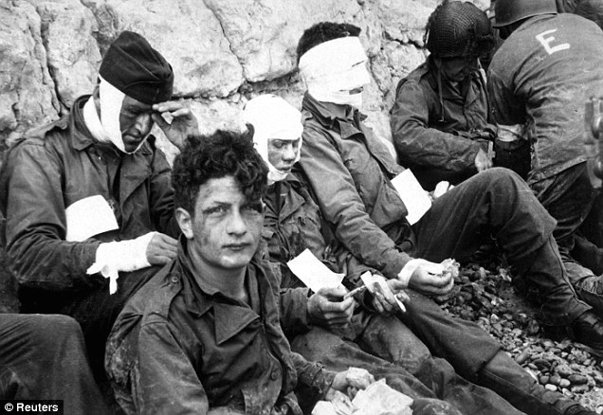
What is the history of this charity?
Oxfam stands for Oxford Committee for Famine Relief and it was founded in Britain in 1942 by a group of people. It helped lots of people in the Second World War as well as becoming the world leader of emergency relief. Nowadays, it helps poor people in many countries.

Slide 5
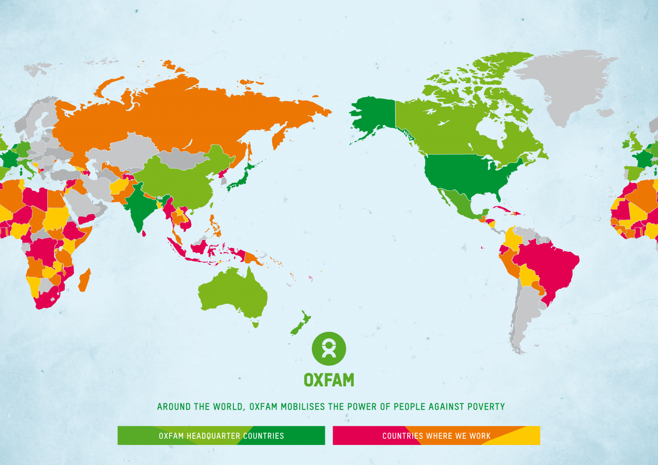
Where is this charity?
Oxfam is based in many places, but the headquarters is in Britain.

Slide 6
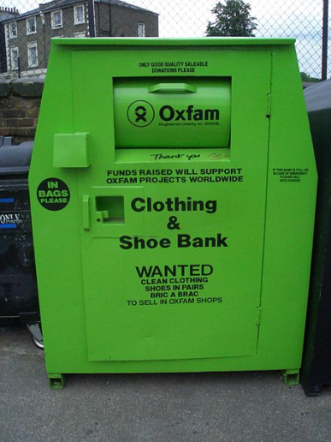
How can we help?
Donations.
School events such as cake sales or non-uniform days.
Become a member of the charity.
Buying Oxfam products like pens or mugs.
Participating in Oxfam events like marathons or walks.
Link to donate http://www.oxfam.org.uk/donate
Link to events and products http://www.oxfam.org.uk/get-involved
Link to Oxfam official web page http://www.oxfam.org/en/about

