Slide 1
The Salvation Army
Erik Sanz

Slide 2
What is a charity?
A charity is a company or organisation which helps many different people and places, such as the poor, animals, and the world from pollution, deforestation, etc.
There are many charities throughout the world and I chose The Salvation Army.

Slide 3
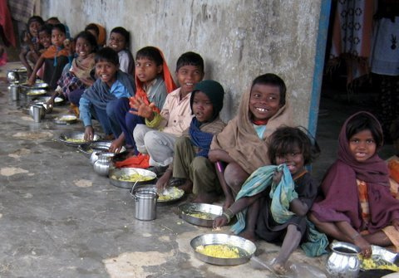
What does this charity do?
The Salvation Army helps the poor and homeless.
They help the poor by:
Giving them money, clothes, food and water.
Building the homeless some shelters.
Making fair trades for the poor.

Slide 4
The history of this charity
This foundation was created in London, U.K, by William Booth and Catherine Booth in 1865.
In-between 1881 – 1885 he already had 250,000 volunteers.
Unfortunately, William Booth died in 1912. It was a great loss to The Salvation Army; however, he laid a firm foundation that was greatly marked in history.

Slide 5
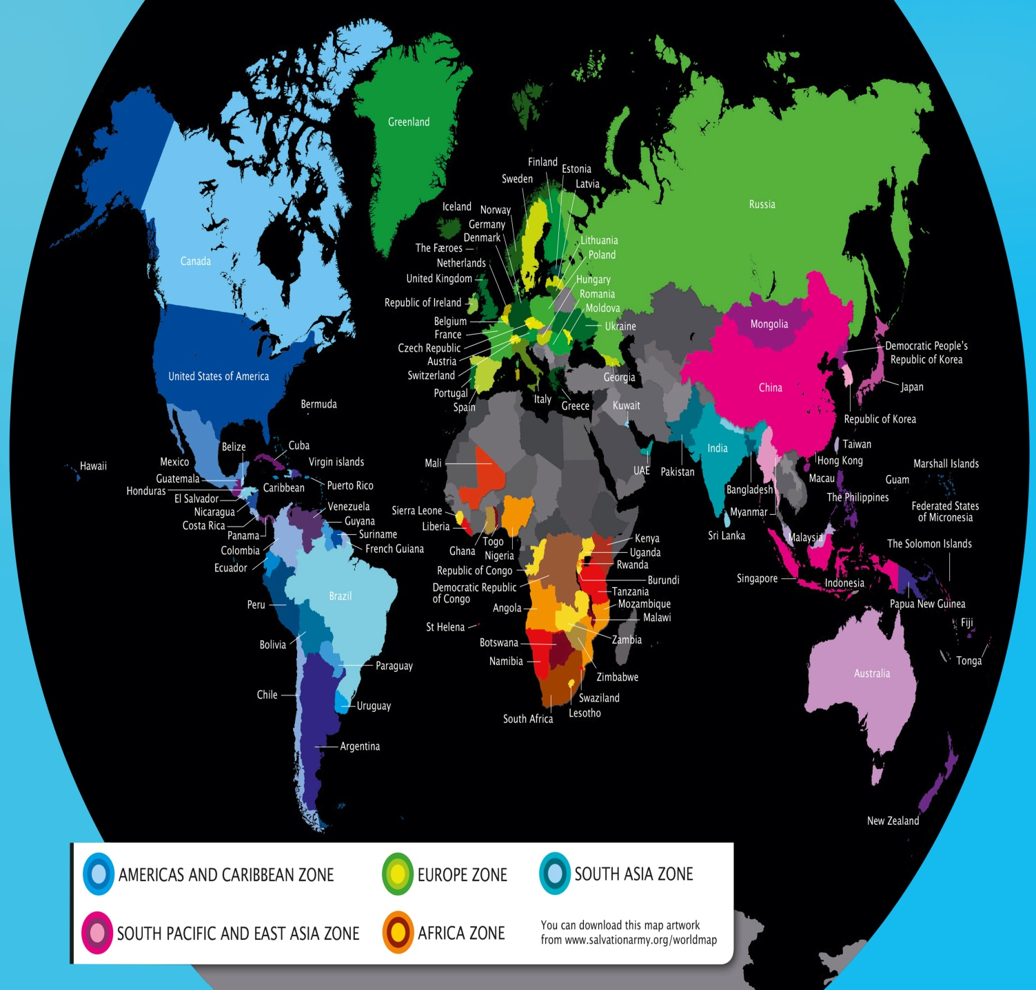
Where is this charity?
This charity is worldwide; it helps a lot of places and therefore a lot of people.
Here is a map of where The Salvation Army helps. -It helps 126 countries in total.

Slide 6
How can we help this charity?
We can help this charity by:
¤ Donating money to the foundation.
¤ Becoming a member/volunteer.
¤ Participating in some of their events.
http://www.salvationarmyusa.org/

