Slide 1
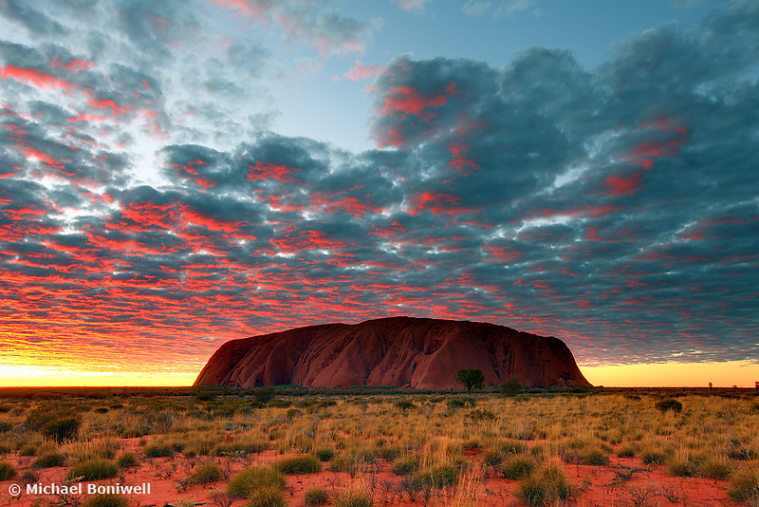
The Effect of White Settlers and Tribal Life
By: Lucía, Alejandra M, Martín and Joaquín.

Slide 2
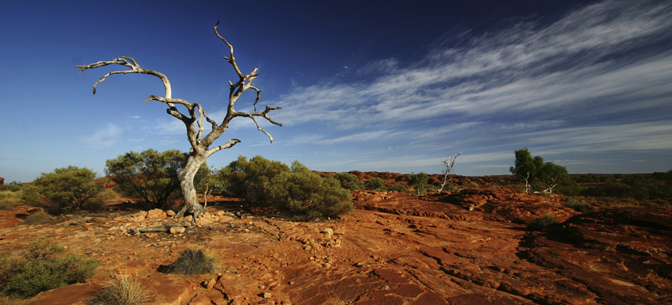
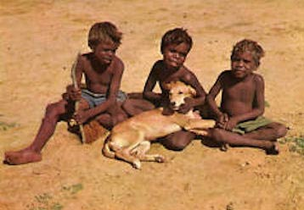
TRIBAL LIFE
Australia has a cool climate and Aborigines often slept below the stars and did not have an exact place to live. They were nomads so they needed to look for the food that they ate.
Warmth and comfort was produced by a camp-fire, and people kept warm by sleeping between them. The dingo was a camp dog that also slept beside people, keeping them warm.
Nomadic Life:

Slide 3
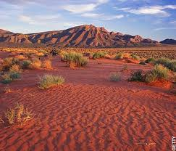
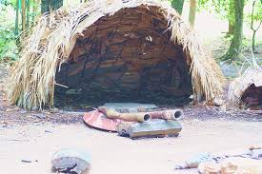
ABORIGINAL HOUSING
Aboriginal houses were made from a framework (a structure that supports or contains something) of straight branches which were covered with other branches that had leaves on them, or sheets of bark, which were the outer part of a tree trunk which you can take off.

Slide 4
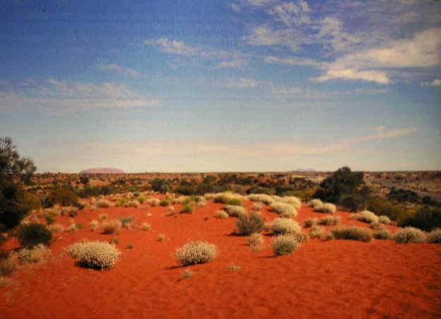
ABORIGINAL HOUSING (2)
The materials which they used to construct their homes depended on available materials in the region. In some places paperbark sheets were taken from trees. In other areas, thick bark, which was difficult to bend, was cut from trees. If there weren’t any of these materials, bushes and branches were applied.

Slide 5
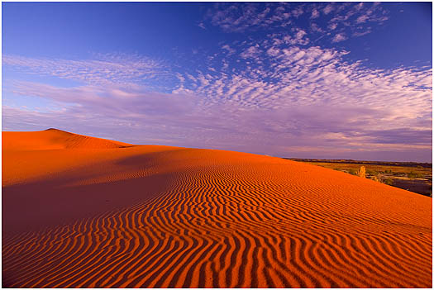
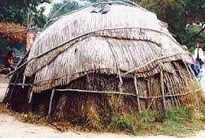
ABORIGINAL HOUSING (3)
When it was cold and wet, circular-shaped shelters were made; they began with long sticks that bent over and met at one point. These measured one or two metres long. In the desert they used grass, twigs (small branches) and leaves.

Slide 6
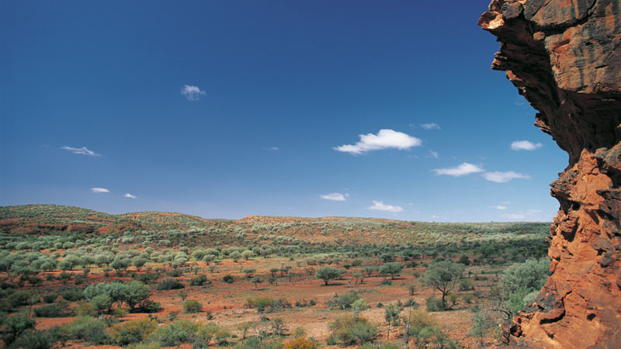
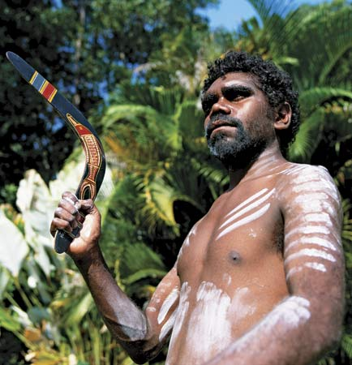
THE BOOMERANG
They used boomerangs for hunting. There are two types of boomerangs: the one that will return when it is thrown and the one that will not return. The one that will not return is used for killing animals, and it looks like a stick. The returning boomerang is used for sports or playing, but it was also used for hunting in the past. This boomerang is formed by two sticks that were stuck together at their edges. If the returning boomerang is thrown correctly, it spins and returns to the one who has thrown it.

Slide 7
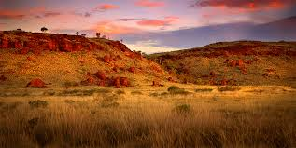
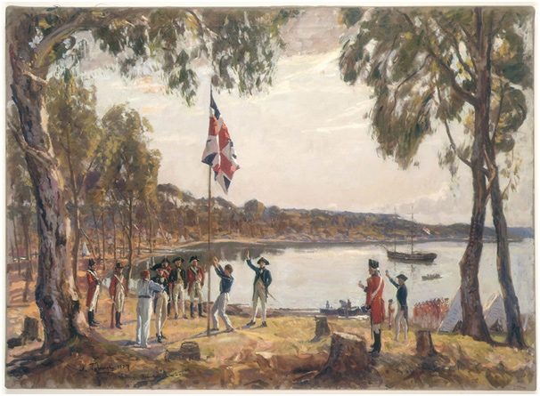
THE EFFECT OF WHITE SETTLERS IN AUSTRALIA
The first Aboriginal settlers settled in Australia between 40,000 and 80,000 years ago where Papua New Guinea actually is. The European settlers arrived in 1788. At this time, the Aborigines were living with the things that nature provided them in Australia.
European settlers arrived with more advanced technology in 1788, educating the Aboriginals the way they wanted.
The European
arrival in Australia.

Slide 8
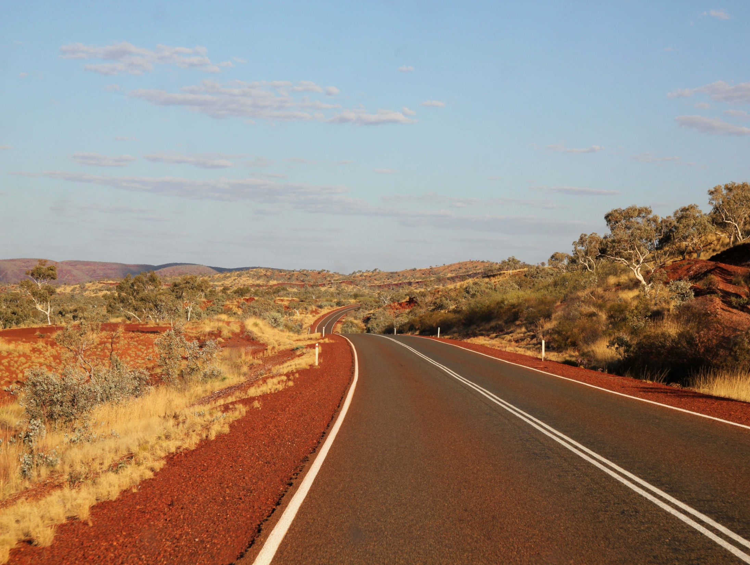
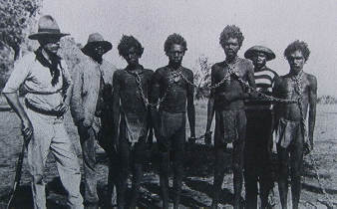
HOW DID THEY CONTROL THE ABORIGINES?
Captain Phillip, who was a British sailor, had been instructed to try and make friends with the Aborigines when he and the other people arrived in Australia, so that they could teach them a new way of life. He was not the only captain that was ordered to make a good relationship with them.

Slide 9
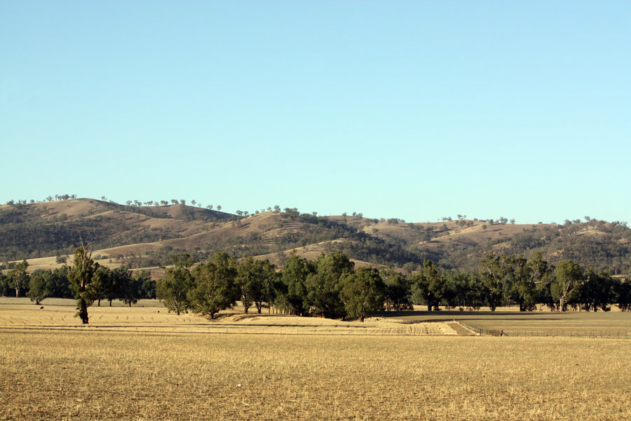
HOW DID THEY CONTROL THE ABORIGINES(2)?
A hundred years later, Aborigines did not have any land of their own. They were struggling for survival. Almost everywhere, white settlers had done lots of terrible things to Aboriginal territory. White settlers and Aborigines had lots of wars between them where Aborigines often died. Normally, all their land belonged to the colonisers and had been changed by them.

Slide 10
Video and extra information
Video:
-http://www.youtube.com/watch?v=YqkgKkW8o6E
Extra information about other themes related to Aboriginals (you need to copy this link and then put it in Internet):
http://www.infoplease.com/spot/aboriginal1.html-
http://www.skwirk.com/p-c_s-14_u-179_t-524_c-1954/act/history/aboriginal-colonisation-and-contact/the-arrival-of-the-british/governor-phillip

Slide 11
Do you want to try a quiz about this project? Click here!

Slide 12
Quiz!
Instructions:
In this quiz, you will be asked some questions about this Powerpoint. Click the correct question. If you click the correct one, you will continue playing, if not, the game will restart.
Click to start

Slide 13
Question 1
Where did the Aborigines normally sleep?:
In huts?
In the open?
In caves?

Slide 14
WRONG!
Click to start again

Slide 15
CORRECT!
Click to go to next question

Slide 16
Question 2
What forms did the Aboriginal houses have in wet and cold conditions?:
Circular-shaped?
Cube-shaped?
Triangular-shaped?

Slide 17
CORRECT!
Click to go to next question

Slide 18
WRONG!
Click to start again

Slide 19
Question 3
What do the Aborigines use the returning boomerang for?:
For hunting?
For playing and for sports?
Or both?

Slide 20
CORRECT!
Click to go to next question

Slide 21
Question 4
When did the first Aboriginal settlers colonise what is now Australia?:
Between 40,000 and 80,000 years ago?
1000 years ago?
30,000 years ago?

Slide 22
CORRECT!
Click to go to next and final question!

Slide 23
Final Question!
When did the European settlers arrive in Australia?:
1659?
1788?
1850?
1720?

Slide 24
YOU HAVE WON THIS QUIZ!
Click to return back to the first slide

