Slide 1
UNICEF
UNICEF
By Jesus Altamirano Picazo
BY JESUS

Slide 2
Unicef
UNICEF makes people happy, gives money, water, food, etc.
They fight against Ebola and other infections that people suffer...
…And only YOU can help fight against it.

Slide 3
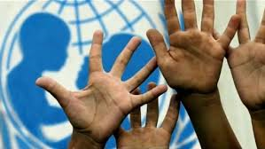
Who does it help?
It is created for poor people that need support.
They want these people to have the attention that they need as they are poor.
The founders from America wanted UNICEF to be like it is now: a large company that helps the poor.

Slide 4
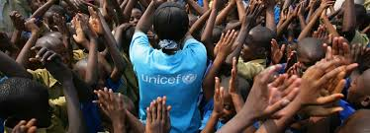
How can you help?
Donate one euro so more people can be safe.
UNICEF wants people to try and find out what it is like to live like the poor.
http://www.unicef.org/

