Slide 1
UNICEF
By Javier Lopez

Slide 2
What is a charity?
A charity is a organisation that helps people who need help, like money, food, water or a home.

Slide 3
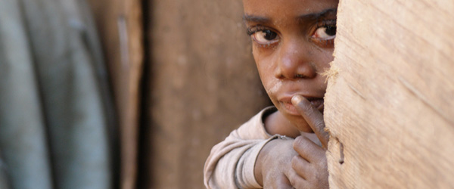
UNICEF
UNICEF is a very big charity because it works with: hunger and malnutrition, war, conflict and disaster.

Slide 4
How they help.
Hunger and malnutrition: lots of people are in danger because they don’t have food to help them live and grow.
Disasters: this is where people lose their homes as a result of floods, earthquakes or typhoons.
War and conflict: from Syria and Iraq to South Sudan and Central African Republic, war and conflict puts millions of children in terrible danger. They face losing their homes, their families, and even their lives.

Slide 5
How can we help?
We can help by: giving money, food, clothes, shoes, old games or things we don’t use.
You can also help by telling your friends or running a cake sale at school.

