Slide 1
UNICEF
By: Eduardo Padilla

Slide 2
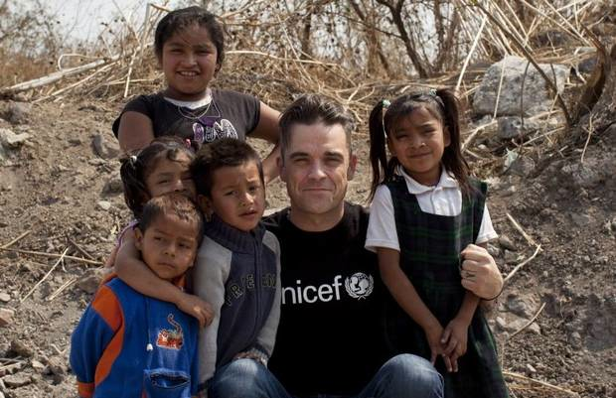
What does this charity do?
Child survival and development.
Basic education and gender equality.
Child protection.

Slide 3
Who does it help?
Saving children’s lives.
Getting every child to school.
Helping those in emergencies.
People that don’t have money.

Slide 4
Where is this charity?
UNICEF’s work is carried out in 191 countries through National committees. Some 88% of the organisation’s posts are located in the field.

Slide 5
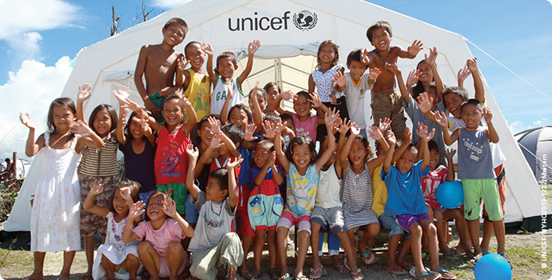
How can we help this charity?
Donating money.
Organising a cake sale at school.
Organising a non-uniform day.
Giving them things that you don’t want that they need.

